Slide 2
Genre-ly speaking
Charles Montgomery Dongguk University English Interpretation & Translation www.ktlit.com

Slide 3
The “genre” filter serves as a brief and necessarily sketchy reminder of the vital importance of assessing the genre-membership of texts, and discovering their genre-related characteristics (Hervey et. al. p 217)

Slide 5
Why do murders always seem to happen on Sundays?
(Kim Young-ha, Photo Shop Murder)

Slide 6
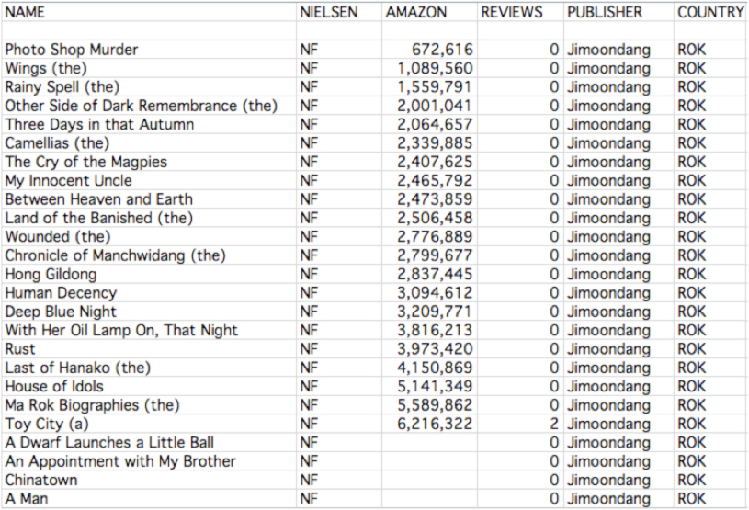

Slide 7
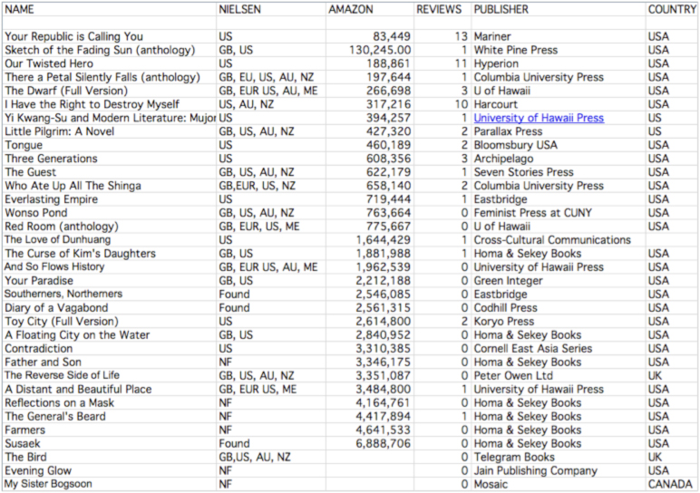

Slide 8
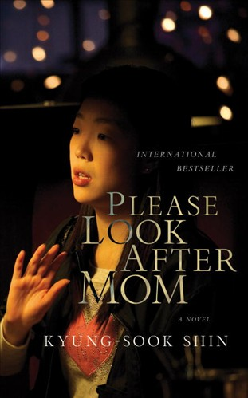

Slide 11
There’s no doubt that short fiction has disappeared from the zeitgeist. Today, stories are communicated to wide audiences only if they’re made into movies. Any publisher will attest that short story collections don’t sell well
(Livings, Newsweek) (Livings, Newsweek)

Slide 15
“Mom is universal material for a novel because everyone has a mom. And every one loses mom some how. That feeling of loss resonates with people not only in the U.S. but in other countries,” Lee told The Korea Herald.
(Kim Yoon-mi)

Slide 16
Notes:
These figures are for e-books which have sold over 1000 copies From http://derekjcanyon.blogspot.com/2011/01/keys-to-epublishing-success.html

Slide 18
Notes:
PUT THE BRITISH ONE UNDERNEATH, THEN FACE TO THIS ONE.

Slide 20
Notes:
These characters, please note, also get to agency..

Slide 22
“LIBRARY” BOOKS

Slide 23
Genre Fit
Photo Shop Murder
Crime
Shinga
Mother/Child
Your Republic
Mystery
Notes:
THE BOUNCE EFFECT

Slide 24
Would Koreans Read This?

Slide 28
Notes:
Arank taken
Arank 2 taken 10.27.10 New taken 4.21.11

Slide 29
Romanization

Slide 30
Find Me
Email: charles@ktlit.com
Web: www.ktlit.com
Twitter: ktlit

Slide 31
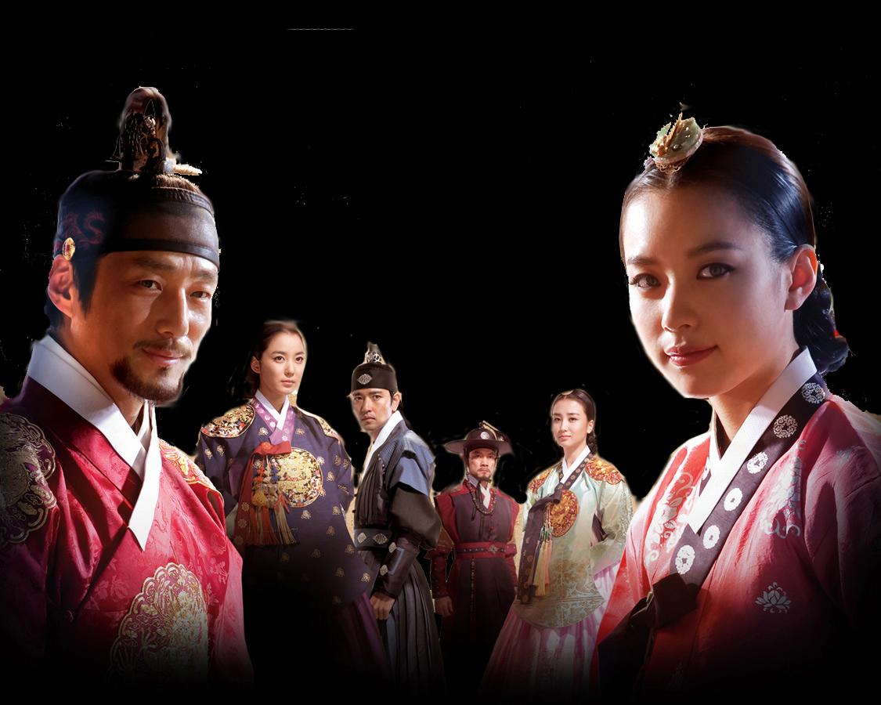
HISTORY
HISTORY

Slide 32
NATURE
NATURE

Slide 33
ANIMISM
ANIMISM

Slide 34
TOTEMISM

Slide 35
SHAMANISM
SHAMANISM

Slide 36
CONFUCIUS
CONFUCIUS

Slide 37
BUDDHA
BUDDHA

