Slide 1
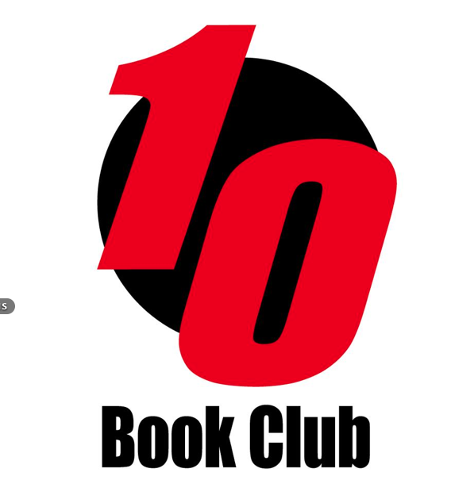
Korean Literature Influences & History
Charles Montgomery Dongguk University English Linguistics, Interpretation and Translation

Slide 2
INFLUENCES
Shamanism
Buddhism
Confucianism
Taoism
Christianity

Slide 3
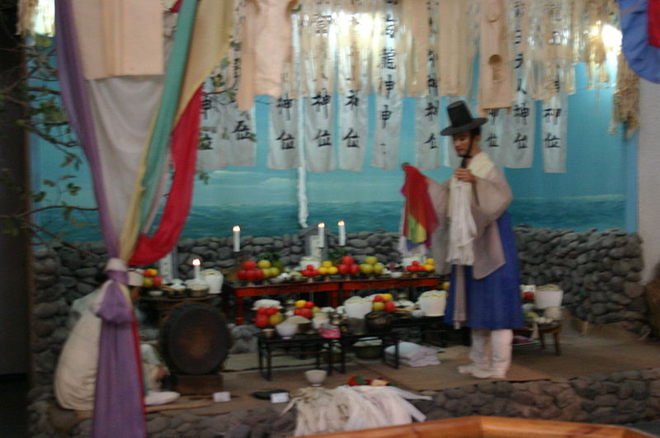
Korean Shamanism
Deep roots in folk beliefs.
Related to ancient communal worship rites offered to gods of heaven.
Seeks to resolve human problems through meeting of humans and spirits mediated by the shaman
Animism
www.sejongculturalsociety.org/mediafiles/resources/korea.ppt
Notes:
Three elements are seen as essential to a “goot” (Korean shamanistic ritual): the spirits as the object of folk beliefs, the believers praying to those spirits, and the shaman mediating between the spirits and the believers.

Slide 4
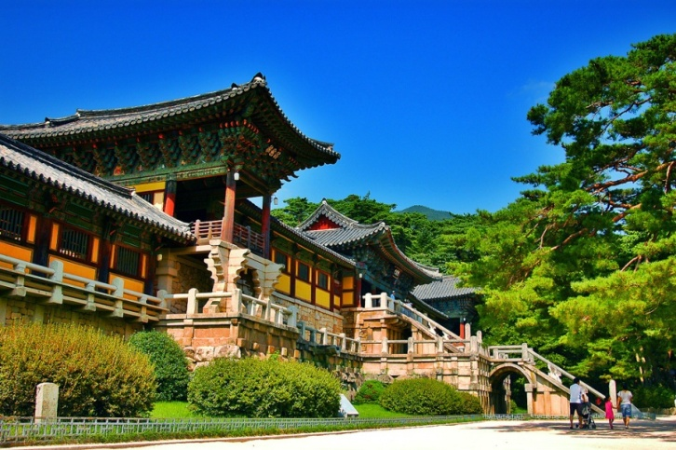
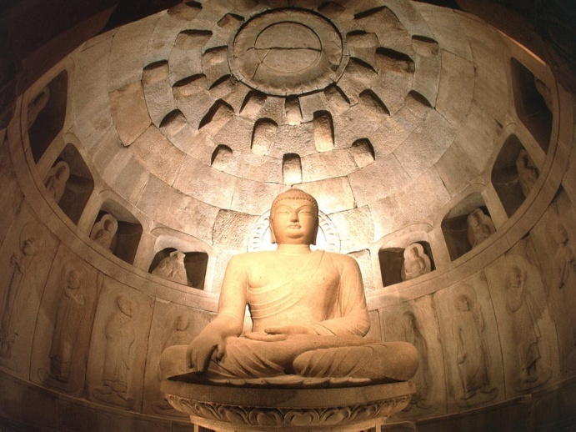
Korean Buddhism
Introduced in three kingdom era (@ 372 A.D.)
State religion in three kingdoms and Goryeo
Deep influence in every aspect of Korean life
Korea still 24% Buddhist.
www.sejongculturalsociety.org/mediafiles/resources/korea.ppt
Notes:
Buddhism is a philosophy and religion, brought to Korea almost 1800 years ago. The principles of Buddhist teaching are deeply rooted in the way of life among Koreans regardless of their religion.
Many national treasures in art and architecture are Buddhism related, such as, Buddhist temple buildings or statues of Buddha.

Slide 5
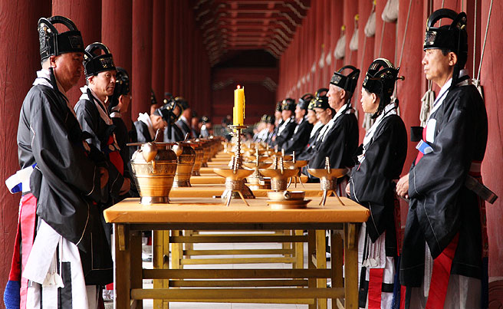
Korean Confucianism
Joseon dynasty promoted Confucian philosophies as national philosophy.
Intellectual Achievement
‘Proper’ Social Structure
www.sejongculturalsociety.org/mediafiles/resources/korea.ppt
Notes:
Joseon dynasty adopted Confucianism as its ruling ideology. Important Korean Confucian ceremonies are “coming of age at age 15 years”, marriage, death, and the anniversary of an ancestor’s death. Among these, funerals had the greatest effect on people’s lives. The funeral was a way of expressing one’s innermost feelings, and its conduct and atmosphere depended on the degree of intimacy or formality in the relationship between the living and the deceased. The Joseon promoted a revised form of Confucianism,calld Neo-Confucianism, that had also been developed in China. In the 18th and 19th centuries, scholars developed and promoted the emergence of Silhak, or Practical Learning, which some see as an early step toward modern social and scientific practices.

Slide 6
TAOISM
Introduced to Korea from China during the Three Kingdoms
Greatest popularity during Goryeo
Remains a minor but significant element of Korean thought and integrates with animism

Slide 7
Korean Christianity
Catholicism imported into Korea by Korean scholar, Yi Seung-hun, who was baptized while visiting China.
Protestant missionaries came during Japanese rule in early 20th century.
Dedicated to higher education and health care
Catholics and Protestants live in urban areas and often have higher education levels.
Notes:
Korea is the only country where Catholicism was brought in by a native missionary, Kim Dae-Gun, who went to a seminary in Macao. Rev. Kim returned to Korea as an ordained priest and was executed during persecution along with thousands of other fellow Catholics. The monument for martyrs is at the site of execution, Jul-Doo-San (meaning “mountain of beheading”).
Protestant evangelists came to Korean during the Japanese colonial occupation. They operated high schools, colleges, and hospitals and gained strong influence among better educated young people.
Currently, Korean missionaries, the world’s second largest group after Americans, are working in more than 150 countries.

Slide 8
What does it add up to?
Balance between emotionalism and control
Substantial tension between beliefs across time and proximally

Slide 9
What Barriers Does this Create?
Flat Affect (High Context)
Little Agency (Socially Determined)
Gatekeeping (Current Manifestation)
Awesome Trauma Levels
Didacticism
Little interest in character motivation
Plots less important than message

Slide 10
Bad Translation
(De) Amplification
Bad themes/genres
Literality
Impossibility

Slide 11
LITERATURE – DIVIDING LINES
Classical (? – Late 19th Century)
Modern (1900 – Now)

Slide 12
LITERATURE – DIVIDING LANGUAGES
Hyangch’al
Chinese
Hangul

Slide 13
LITERATURE – DIVIDING RELIGIONS
LOL… saved for another lecture.^^

Slide 14
LITERATURE – DIVIDING LINES
Men
Women

Slide 15
LITERATURE – DIVIDING LINES
Between Dynasties

Slide 16
Why include oral/song content?
Chinese vs. Korean
Little printing
Many wars
Successive dynastic destruction of written materials
Hey! Epics.

Slide 17
Korea’s Classical Poetry
Hyangga
Koryo Kasa
Sijo
Joseon Kasa
Pansori

Slide 18
Hyangga
Very little remains of the literature of the Silla Period (57 BC to 935 AD). What does remain is the form of Hyangga poetry, which was written down in hyangch’al.
4-line, 8-line, and 10-line poems. 4-line hyangga one stanza, 8-line hyangga two 4-line stanzas, and 10-line hyangga are two 4-line stanzas concluding with one two-line stanzas.

Slide 19
Requiem for My Sister (Weolmyeong)
The road to life and death Stands fearfully before us. Without saying good-bye, Have you left me?
The early morning wind in autumn Scatters leaves here and there. Though from the same branch They know not where they've gone.
Oh my dear sister, to see you again in Amitabha's Paradise, I shall wait, perfecting Buddha's way.

Slide 20
Koryo Kasa
Short (one stanza - dallyeonche)
Long (yeonjanche stanzas range to 13)
Stanzas have refrain in the middle/end to establish mood or link the stanzas
Less formally structured
Bolder topics
Often performed by Kisaeng

Slide 21
The Manjeoncheun
When I lie alone, restless, vigilant, Only peach blossoms wave over the west window. You have no grief, welcome the spring breeze.
I have believed those who vowed to each other; "My soul will follow yours forever." Who, who persuaded me this was true?
"O duck, beautiful duck, why do you come To the swamp, instead of the shoal?" "If the swamp freezes, the shoal will do."
A bed on Mount South, jade pillow, gold brocade. And beside me a girl sweeter than musk, Let us press our hearts together, our magic hearts.

Slide 22
Sijo
Joseon poetry shifts to sijo/kasa
Original sijo poets were yangban
3 lines of 14-16 syllables each. Total syllables between 44 and 46
Also syllabic rules for each line
Rules almost always broken, as sijo aren’t really syllabic.^^

Slide 23
Yi Sun-sin
Moon-bright night on Hansan Isle and I sit alone atop the lookout. I hold my great sword by my side, and as my worries deepen, from somewhere comes the single note of the Mongol flute, piercing to the very bowels.

Slide 24
Joseon Kasa
Free verse, based on a rhythm of doubled feet with three or four syllables
Not stanzas
More narrative/descriptive

Slide 25
Kasa
There is between heaven and earth many a man who’s worth as I. Why don’t they know the great Joy Of living in the wooded mountains? With a grass hut of a few bays built to face a clear blue stream, In the lush wood of pine and bamboo I am the master of wind and moon.

Slide 26
Pansori
Narrative poetry focused on real life
From shamanist chants of S-E Korea in late 17th and early 18th centuries
Long narrative musical performance with drummer and singer
A main song called ch’ang and a rhythmic spoken connective called aniri

Slide 27
Classical Prose
Tales of Kumo by Kim Shi-sup in the mid 15th century
The Tale Of Hong Gildong by Hyo Kyun in the late 16th or early 17th century.

Slide 28
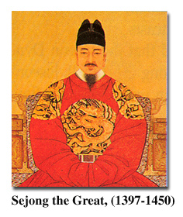
Korean Alphabet: Hangul
King Sejong the Great invented Korean alphabet in 1446.
Alphabet organizes written language into syllabic units.
14 consonants & 10 vowels
Easy to learn:
"A wise man can acquaint himself with them before the morning is over; a stupid man can learn them in the space of ten days”.
From http://library.thinkquest.org/20746/non/info/index.html
Notes:
Hangul is the only alphabet in the whole world invented by one person. It is a purely phonetic alphabet with 10 vowels and 14 constants.
Koreans used Chinese characters before the invention of Korean alphabet. The majority of Koreans were effectively illiterate before the invention of Hangul.
In explaining the need for the new script, King Sejong explained that the Korean language was different from Chinese; using Chinese characters to write was so difficult for the common people that only privileged aristocrats, usually male, could read and write. Hangul was designed so that even a commoner could learn to read and write.
"Hunmin Jeong-eum Explanation and Examples“ explains the design of the consonant letters according to “articulatory phonetics” and the vowel letters according to the principles of “yin and yang” and “vowel harmony”.
From http://library.thinkquest.org/20746/non/info/index.html

Slide 29
KOREAN CLASSICAL LIT
Oral
Therefore poetic
Chinese Characters
Full of influences we just discussed.

Slide 30
ONCE MORE: INFLUENCES^^

Slide 31
GENRES
Lyric
Narrative
Dramatic
Didactic

Slide 32
Lyric
Hyangga
Sijo and Narrative sijo
Light Songs
Lyric Folk Songs
Most classical Chinese poetry
19th Century poetry & most modern poetry

Slide 33
Narrative
Myths
Narrative Poems
Narrative Shaman Chants
Pansori
Classic and New Novels

Slide 34
Dramatic
Mask Dance
Puppet Theater
New Theater
Modern Drama

Slide 35
Didactic
Court Music (akchang)
Ch'angga
Diaries
Travelogues

Slide 36
Kim Sat-gat (Sakkat)

Slide 37
Enlightenment
Late 19th Century
Korea’s attempt to ‘modernize’ itself

Slide 38
Summary of Classical Trends
Slow but general move towards hangul
Consequently slow but general move to expanded authorship
Slow by general move away from rarefied themes
Late development of publishing and commercial authors

Slide 39
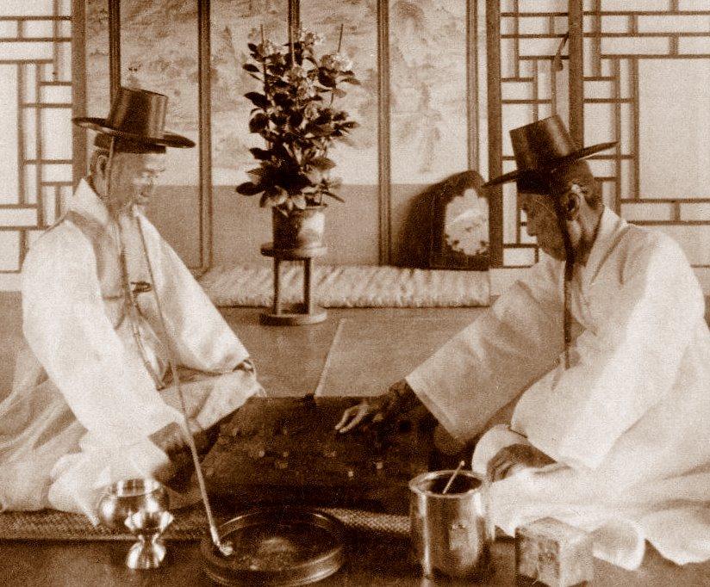
The Death of the Yangban
Yangban was de jure conferred to those individuals who passed state-sponsored civil service exams called gwageo
Slow
Deliberative
Chinese Language

Slide 40
Early Colonialism
Early Years 1905 - 1919 The shock of “failure” and Yi Kwang-su Serialization
Post 삼일 False Summer

Slide 41
1935-1945: The “Dark” Years
Early Years
The Roaring 30s
Everyday Life in the Empire
Writings in Korean, Writing in Korean
Total Mobilization
Censorship
Writing in Japanese

Slide 42
1945-1960s: Liberation, Division, and War
Kapitan Lee (Chon Kwangyong) and Obaltan (Yi Beomseon)
Questions of Loyalty
A Divided Country, Divided Families
Post Traumatic Stress Syndrome
The Urge to Return (But to Where and What?)
Cranes (Hwang Sun-won)
Redefining Right and Wrong
Possibilities for Reconciliation

Slide 43
Late-Twentieth Century Literature
Miracle on the Han
Resettlement
Destruction of old social models
Rootlessness

Slide 44
Late-Twentieth Century Literature
Miracle on the Han
Seoul, 1964, Winter
A Little Ball Launched by a Dwarf
The Flower with Thirteen Fragrances

Slide 45
Yoryu Chakga: The Changing Status of Women Writers
A Genre unto Themselves:
Women Writers and Segregation
Turn of the Century:
Women Writers as the Dominant Force in Korean Literature

Slide 46
Coming Full Circle: Rescuing Literature From the Nation
Nationalism in Literary Production
Writers Unbound
Kim Young-ha
Jung Young-moon
Pak Min-gyu
Kim In-sook

Slide 47
The Future
Revisiting Language and Ethnicity
Future Writers
Koreans in English
Others in Korean
Internationalization
Nation vs Inter-nation
Nobel Prize
Shin Kyung-sook
Tension with “national” literature

Slide 48
Find Me
WWW.KTLIT.COM
CHARLES@KTLIT.COM
@KTLIT

