Slide 2
Korean Literature In a Few Short Stories
Charles Montgomery Dongguk University English Linguistics, Interpretation and Translation

Slide 3
The Eras
Enlightenment (End of Joseon) Who cares?^^
Colonial (Three eras/Two theories)
Separation
Modernization / Industrialization
Post Modern

Slide 4
Colonial Era (1906-45) Works discussed
A Society that Drives You to Drink (Hyon Chin-gon) in A Ready Made Life; on Brother Anthony’s hompi
Wings (Yi Sang)

Slide 5
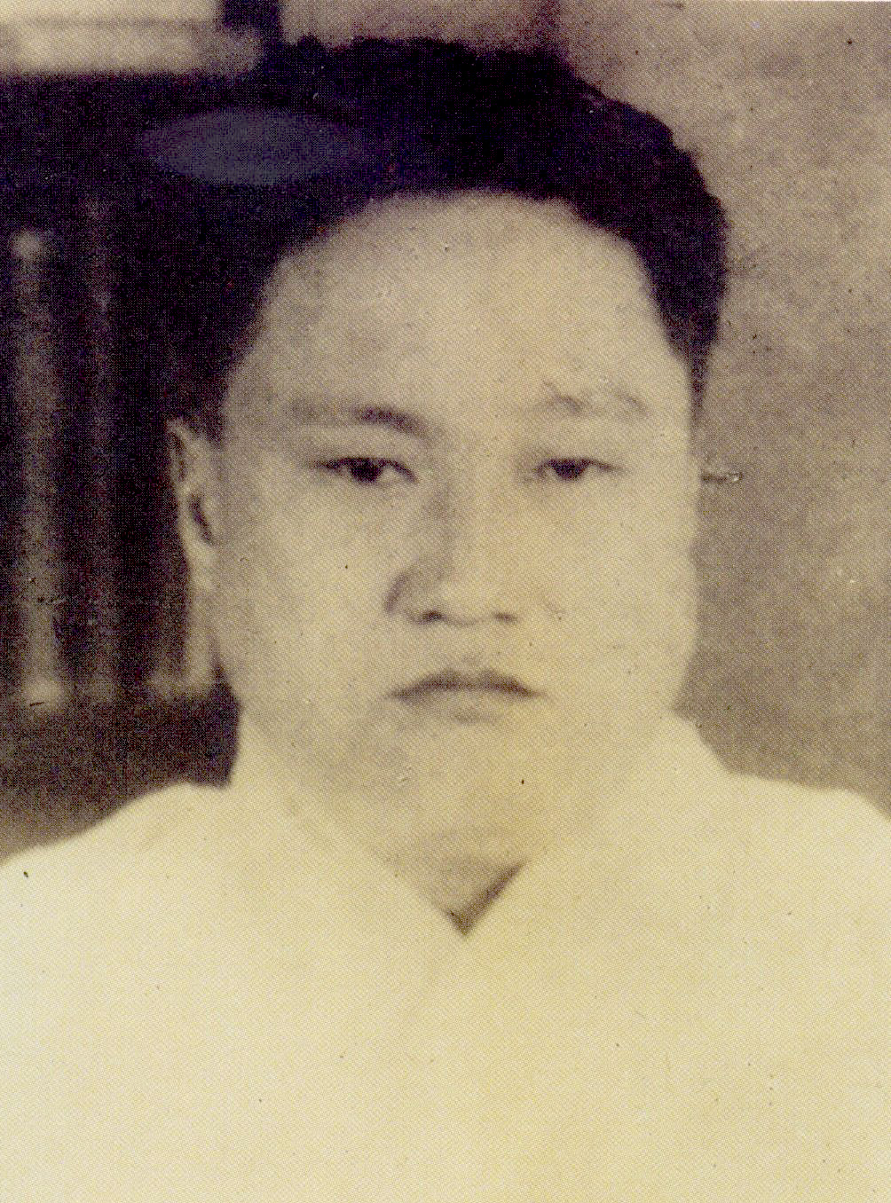
Hyon Chin-gon
Born in Korea 1900
Educated here and in Shanghai
One of the fathers of realistic fiction
A Lucky Day / Fire

Slide 6
Hyon Chin-gon: A Society that Drives you to Drink
Japanese educated
Can’t find job
Tangled up in factionalism
Undereducated wife

Slide 7
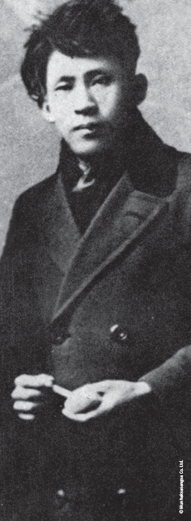
Yi-Sang: Bio
Born August 20, 1910
Most works during the 1930s
Architect/Draftsman
1936 arrested for “thought crimes”
Tubercular/worsens in prison
Dies April 17, 1937

Slide 8
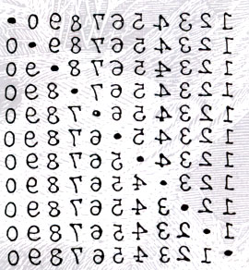
Yi-Sang: Poetry

Slide 9
Yi-Sang: Wings (날개)
Alienated semi-schizophrenic narrator
Hermetically sealed life. Intent on escaping from the everyday world of frustration and negation
Cannot see the situation he is in
Longs to get “wings”

Slide 10
Colonial Recommended
Heartless (Yi Kwang-su) Pros – first “modern” novel Cons – old style, didactic
Three Generations Pros – exhaustive Cons – exhaustive^^
A Society that Drives You to Drink (Hyon Chin-gon) Pros – excellent outline Cons – maudlin
Wings (Yi Sang) Pros – evocative, modern Cons – modern^^

Slide 11
Separation Period (1945-Present) Work Discussed
Hwang Sun-won’s Cranes in Lost Souls

Slide 12
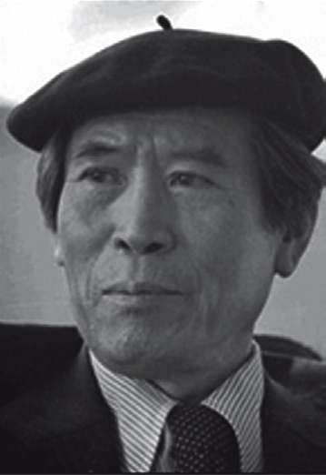
Hwang Sun-won: Korea’s Dickens
Born March 26, 1915
Died September 14, 2000
Writer, novelist, and poet
Began in Colonial Period
Refused to write in Japanese – went underground

Slide 13
Hwang Sun-won: Cranes
Crane is a symbol for Korean people
Songsam and Tokchae
Tokchae was a communist
As boys they tied up then let a crane free
Songsam does the same for Tokchae.

Slide 14
Separation Recommended
Cranes (Hwang Sun-won) in Lost Souls
An Appointment With My Brother (Yi Mun-yol) Portable Library of Korean Literature
Drifting House (Krys Lee) in Drifting House

Slide 15
Industrialization Period (1960-96) Work Discussed
Cho Se-hui The Dwarf

Slide 16
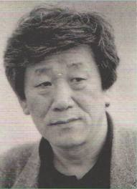
Cho Se-Hui: Bio
August 20, 1942
Member of the "hangul generation"

Slide 17
Cho Se-Hui: The Dwarf
The Dwarf is a yŏnjak sosŏl
Three stories in one
Loss of Community
Economic dislocation
Government-mandated

Slide 18
Miracle on Han Recommended
The Dwarf Cho Se-hui
Seoul: Winter, 1964 (Kim Seung-ok) in Modern Korean Fiction An Anthology”
A Distant and Beautiful Place (Yang Kwi-Ja)
The Flower with Thirteen Fragrances (Ch’oe Yun) in There a Petal Silently Falls

Slide 19
Romance?
A Lucky Day (Hyon Chin-gon)
The Scorching Heat (Ch’ae Mansik)
The Flower with 13 Fragrances

Slide 20
Post-Modern Period (1995 – Now) Work discussed
Whatever Happened to the Guy in the Elevator (Kim Young-ha) in Photo Shop Murder

Slide 21
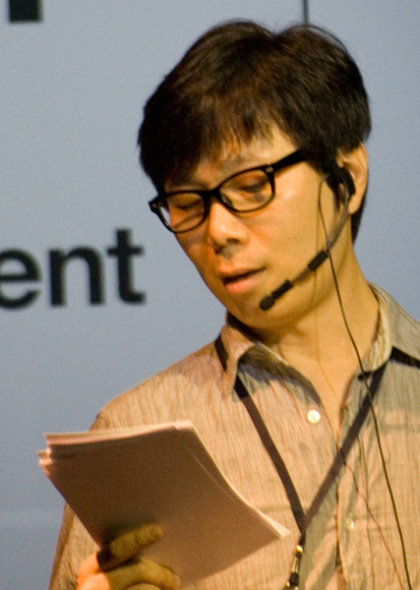
Kim Young-ha: Bio
Born in Hwacheon
Moved a lot
Lived near the 38th
Gas poisoning as a youth
Army detective

Slide 22
Kim Young-Ha: “Elevator”
A day gone wrong
Absurd
Impersonal – NO social relationship
Funny

Slide 23
Funny?
Ch’ae Mansik
Some collaboration fiction
Most North Korean fiction^^

Slide 24
Post-Modern Recommended
Kim Young-Ha – all work
Pak Min-Gyu – all work Available online
Shin Kyung-sook Please Look After Mother

Slide 25
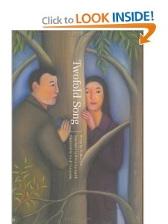
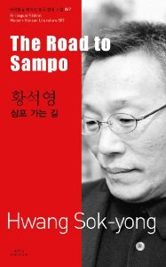
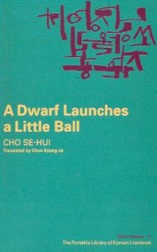
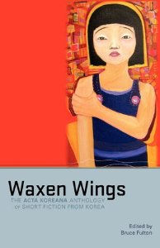
Suggestions
Asia Press
Portable Library of Korean Fiction
Hollym
Waxen Wings

Slide 26
Resources
All the Literature that’s free^^
Brother Anthony’s hompi
Korea Journal
LTI Korea website
WWW.KTLIT.COM
Korean Film Archive

Slide 27
LTI Korea Podcasts (Itunes)

Slide 28
Find Me
WWW.KTLIT.COM
CHARLES@KTLIT.COM
@KTLIT

