Slide 1
TRANSLATED Korean Literature In 60 minutes or thereabouts!
Pssssst…….Q&A as we go, please!

Slide 2
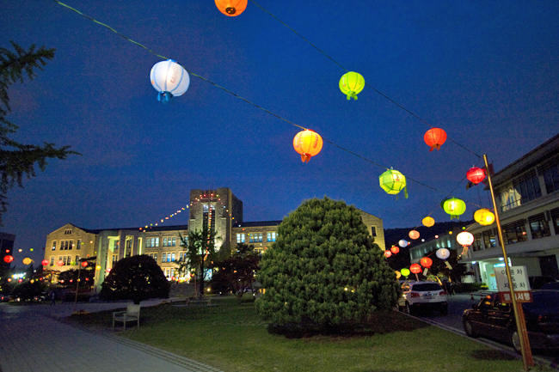
Who Am I?
Associate Professor at Dongguk
www.ktlit.com
Various projects with LTI Korea
Ex marketer
Translation Editor
Poor Korean

Slide 3
What I Will Discuss
Why is Korean literature distinctive?^^
Pre-modern and modern periods (and eras within eras within eras) of Korean Literature
The strong relationship between Korean Literature and Culture/History

Slide 4
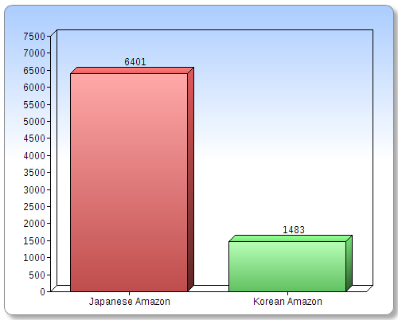
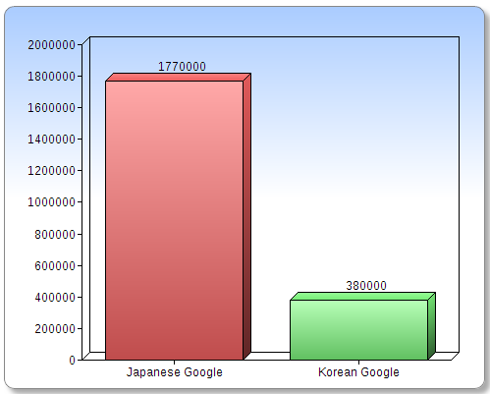
Little Success: Web Survey

Slide 5
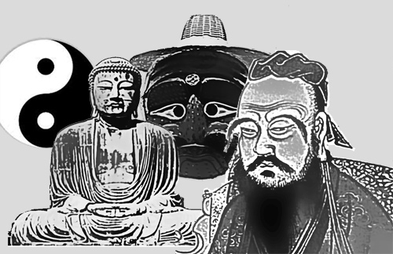
To Understand Early Korean Literature

Slide 6
Influences
Shamanism
Buddhism
Confucianism
Taoism
Christianity (but way later)

Slide 7
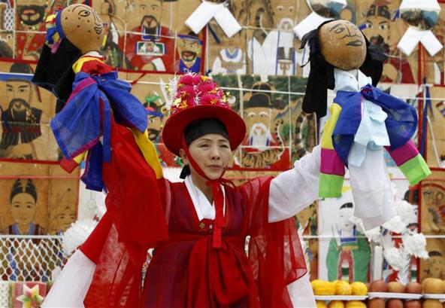
Korean Shamanism
Notes:
Roots in folk beliefs related to ancient communal worship rites offered to gods
Resolution of problems through meeting of humans and spirits mediated by shamans
Three elements are seen as essential to a “goot” (Korean shamanistic ritual): the spirits as the object of folk beliefs, the believers praying to those spirits, and the shaman mediating between the spirits and the believers.

Slide 8
Mediation
Spirits
Ancestors
Nature

Slide 9
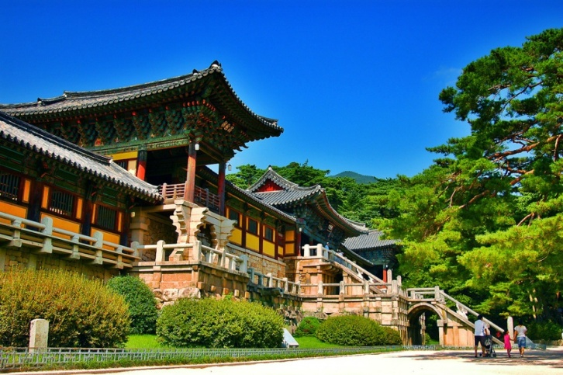
Korean Buddhism
Notes:
Introduced in three kingdom era (@ 372 A.D.)
State religion in three kingdoms and Goryeo
Deep influence in every aspect of Korean life
Korea still 24% Buddhist.
Buddhism is a philosophy and religion, brought to Korea almost 1800 years ago. The principles of Buddhist teaching are deeply rooted in the way of life among Koreans regardless of their religion.
Many national treasures in art and architecture are Buddhism related, such as, Buddhist temple buildings or statues of Buddha.

Slide 10
Next Time!
I swear we’ll get that incarnation right!^^

Slide 11
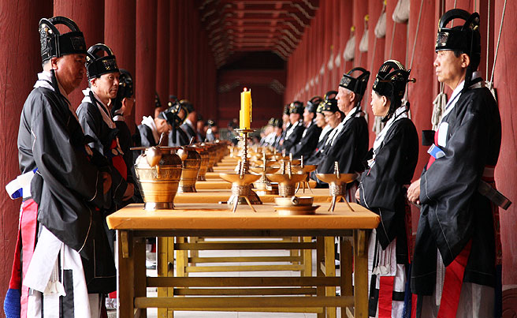
Korean Confucianism
Notes:
Joseon dynasty promoted Confucian philosophies as national philosophy.
Intellectual Achievement
‘Proper’ Social Structure
Joseon dynasty adopted Confucianism as its ruling ideology. Important Korean Confucian ceremonies are “coming of age at age 15 years”, marriage, death, and the anniversary of an ancestor’s death. Among these, funerals had the greatest effect on people’s lives. The funeral was a way of expressing one’s innermost feelings, and its conduct and atmosphere depended on the degree of intimacy or formality in the relationship between the living and the deceased. The Joseon promoted a revised form of Confucianism,calld Neo-Confucianism, that had also been developed in China. In the 18th and 19th centuries, scholars developed and promoted the emergence of Silhak, or Practical Learning, which some see as an early step toward modern social and scientific practices.

Slide 12
5 Relationships
1) Ruler to Subject
2) Father to Son
3) Elder Brother to Younger Brother
4) Husband to Wife
5) Friend to Friend
The preceding parts are superior to the antecedent, except for #5 where they're equal IF OF THE SAME AGE.

Slide 13
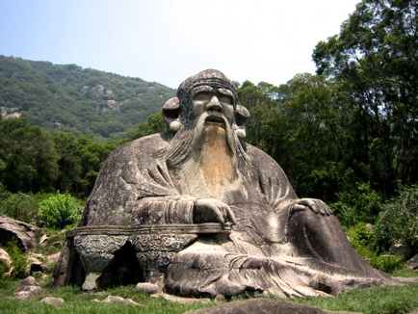
TAOISM: Lao Tzu
Notes:
Introduced to Korea from China during the Three Kingdoms
Greatest popularity during Goryeo
Minor but significant element of Korean thought and integrates with animism

Slide 14
Harmony
Emphasizes living in harmony with the way/path.

Slide 15
What Does It Add Up To?
Balance between emotionalism and control always a question
“Moral” or “Dynastic” code underlies much of it

Slide 16
Oh yeah….
China
Japan

Slide 17
Some Cultural Differences*
Very Broad Strokes Adapted from Chinese-born German designer Yang Liu. *That just might influence readers or writers.^^

Slide 23
High Context / Low Context

Slide 25
What Barriers Does this Create?
Flat Affect (High Context – Fewer heroics)
Less Agency (Socially Determined)
Gatekeeping
Awesome Trauma Levels
Didacticism
Reduced interest in explicit character motivation
Plots less important than message

Slide 26
Bad Translation
(De) Amplification
Different themes/genres
Literality
Impossibility
Bad incoming translation

Slide 27
Who Cares?
Consider “Sonagi” (소나기)
Consider “Buckwheat Seasons” (메밀꽃필무렵)
Consider “Descendants of Cain”

Slide 28
Literature – Dividing Lines
Classical (? – Late 19th Century)
Modern (1900 – Now)
Post-Modern

Slide 29
Literature – Dividing Languages
Hyangch’al
Chinese
Hangul

Slide 30
Koryo Kasa
One to thirteen stanzas
Stanzas have refrain in the middle/end to establish mood or link the stanzas
Informal, bolder, Kisaeng

Slide 31
Joseon Kasa
Free verse, based on a rhythm of doubled feet with three or four syllables
Not stanzas
More narrative/descriptive

Slide 32
Kasa
There is between heaven and earth many a man who’s worth as I. Why don’t they know the great Joy Of living in the wooded mountains? With a grass hut of a few bays built to face a clear blue stream, In the lush wood of pine and bamboo I am the master of wind and moon.

Slide 33
Sijo
Joseon poetry shifts to sijo/kasa written by Yangban
3 lines of 14-16 syllables each. Total syllables between 44 and 46
Rules almost always broken, as sijo aren’t really syllabic^^

Slide 34
Yi Sun-sin
Moon-bright night on Hansan Isle and I sit alone atop the lookout. I hold my great sword by my side, and as my worries deepen, from somewhere comes the single note of the Mongol flute,piercing to the very bowels.

Slide 35
Pansori
Narrative poetry focused on real life from shamanist chants of S-E Korea in late 17th and early 18th centuries
Long narrative musical performance with drummer and singer
Literature like Homer – spoken first, then written.

Slide 36
Korean Classical Literature
Oral
Therefore often poetic
Chinese Characters
Full of influences we just discussed

Slide 37
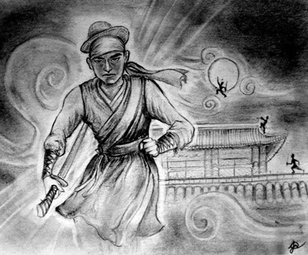
Classical Prose
Tales of Kumo by Kim Shi-sup in the mid 15th century
The Tale Of Hong Gildong by Hyo Kyun in the late 16th or early 17th century

Slide 38
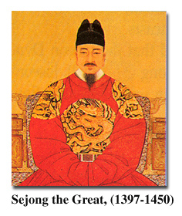
Korean Alphabet: Hangul
Invented by King Sejong the Great in 1443
14 consonants & 10 vowels
"A wise man can acquaint himself with
them before the morning is over; a
stupid man can learn them in the space
of ten days”.
Notes:
Hangul is the only alphabet in the whole world invented by one person. It is a purely phonetic alphabet with 10 vowels and 14 constants.
Koreans used Chinese characters before the invention of Korean alphabet. The majority of Koreans were effectively illiterate before the invention of Hangul.
In explaining the need for the new script, King Sejong explained that the Korean language was different from Chinese; using Chinese characters to write was so difficult for the common people that only privileged aristocrats, usually male, could read and write. Hangul was designed so that even a commoner could learn to read and write.
"Hunmin Jeong-eum Explanation and Examples“ explains the design of the consonant letters according to “articulatory phonetics” and the vowel letters according to the principles of “yin and yang” and “vowel harmony”.
From http://library.thinkquest.org/20746/non/info/index.html

Slide 39
Country | Time
2333 B.C. | Go-Joseon
1st century B.C. | Three kingdoms (Shilla, Baekje and Goguryeo)
668 – 935 A.D. | Shilla (south: 668-935) Balhae (north: 698-926)
935 - 1392 | Goryeo Dynasty
1392 – 1910 | Joseon Dynasty
1910 - 1945 | Japanese rule
1945 - 1963 | Division
1963 - 1997 | Miracle
1997 - Now | Post - modern
Now -> ? | Internationalization

Slide 40
Korean Economy - 5 Centuries in 1; Literature 3 in 1
Enlightenment (End of Joseon)
Colonial (Three eras)
War
Separation
Industrialization / Modernization
Post Modern
Notes:
Commercial farming begins in the 16th century in Britain.

Slide 41
Colonialism
Forced warped Modernization/Japanization
Three eras – 1,2,3
Stories of no opportunity
The “Modern” Woman
Nature stories
Collaboration

Slide 42
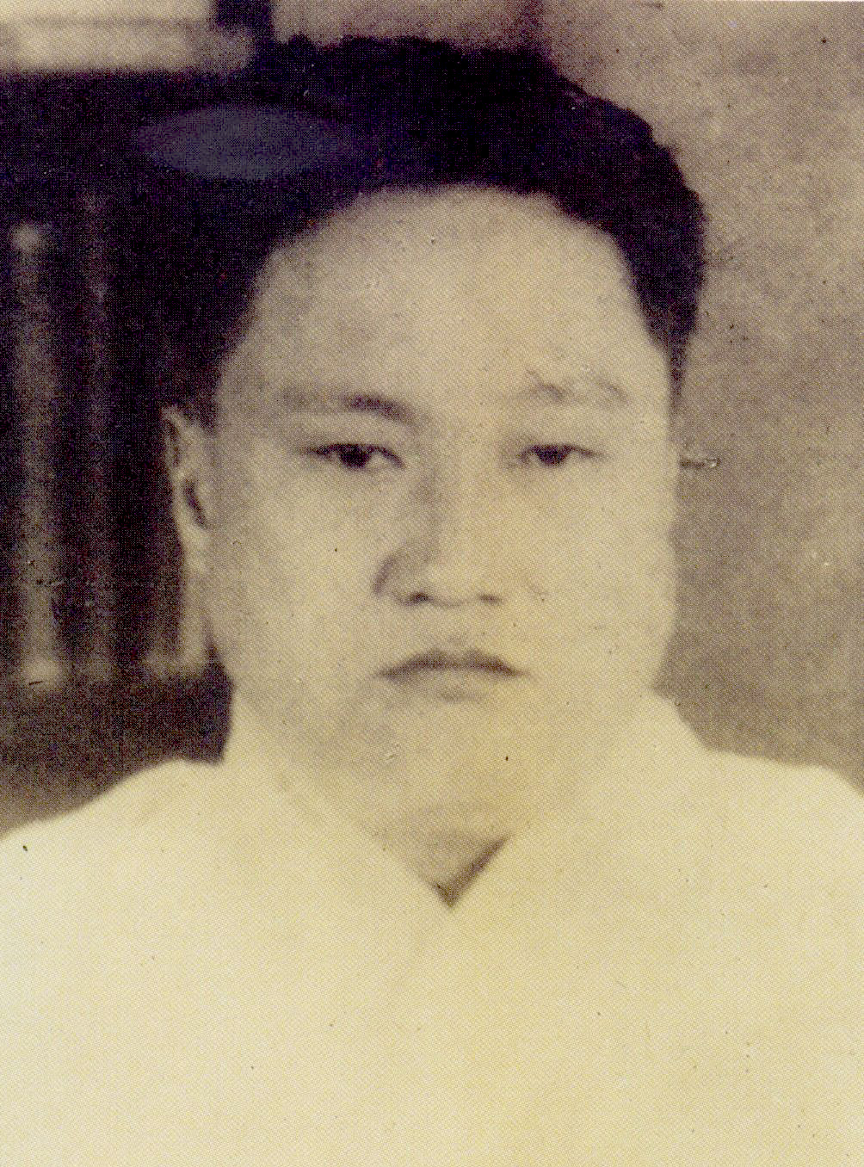
Hyon Chin-gon
One of the fathers of realistic fiction
A Lucky Day / Fire
A Society that Drives you to Drink Japanese educated Can’t find job Tangled up in factionalism

Slide 43
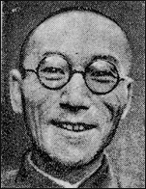
Yi Kwangsu
1910-19 (Heartless) attacks Korea's traditions advocates adopting a western worldview. Essays define “new” literature
20s to 30's becomes dedicated nationalist advocates moral overhaul. Jailed in 36 blames Koreans for being defeatist
Dies unresolved

Slide 44
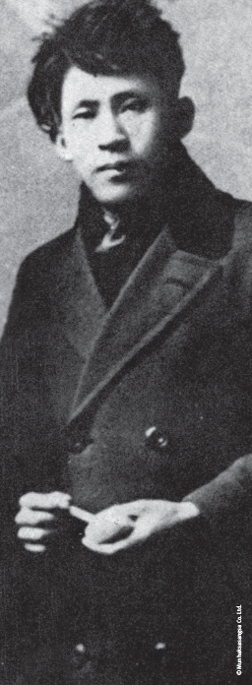
Yi-Sang
World’s Most Interesting Man?^^
Most works during the 1930s
Architect/Draftsman
1936 arrested for “thought crimes ” Tubercular/worsens in prison
Dies April 17, 1937

Slide 45
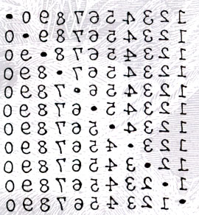
Yi-Sang: Poet

Slide 46
Yi-Sang: Wings (날개)
Alienated semi-schizophrenic narrator
Hermetically sealed life
Cannot see his situation
Longs to get “wings”

Slide 47
WWII and Vietnam
How in Heaven's Name: A Novel of World War Two (Cho Chong-nae)
The Shadow of Arms (Hwang Sok-Yong)

Slide 48
Civil War?
Small, local stories
No (translated) Gone With the Wind or Naked and the Dead

Slide 49
Separation Period / Pundan Munhak (1945-Present)
Hwang Sun-won’s Cranes or his Descendants of Cain.
Jo Jung-Rae’s The Land of the Banished
Hyun Ki-young’s Sun’i Samch’on
Hwang Sok-yong’s The Guest

Slide 50
Hwang Sun-won: Korea’s Dickens
Writer, novelist, and poet
Began in Colonial Period
Refused to write in Japanese – went underground

Slide 51
Miracle on the Han: Economics
Cho Se-hui’s The Dwarf
Yun Heung-gil’s The Man Who Was Left as Nine Pairs of Shoes
Yang Gui-Ja’s A Distant and Beautiful Place

Slide 52
Miracle on the Han: Politics
Ch’oe Yun’s There a Petal Softly Falls
Lim Chul-woo’s Straight Lines and Poison Gas
Gong Ji-young’s Human Decency

Slide 53
Cho Se-Hui: The Dwarf
The Dwarf is a yŏnjak sosŏl
Three stories in one
Government mandated loss of Community & economic dislocation

Slide 54
Modern Period (19?? – Now)
Whatever Happened to the Guy in the Elevator (Kim Young-ha) in Photo Shop Murder
No One Writes Back (Jang Eun-jin)
Most of the authors I will note at the end of this presentation

Slide 55
Yoryu Chakga: The Changing Status of Women Writers
A Genre unto Themselves:
Women Writers and Segregation
Turn of the Century:
Women Writers as the Dominant Force in Korean Literature

Slide 56
Kim Young-ha: Bio
Lived near the 38th
Gas poisoning as a youth
Army detective
“Be an Artist Now” on TED

Slide 57
Kim Young-Ha: “Elevator”
A day gone wrong
Absurd
NO social relationships
Funny

Slide 58
Post-Modern - Just now beginning to be translated
Pak Min-gyu
Jung Young-moon
Ch’oe In-ho

Slide 59
Park Min-gyu
Funny
Attacks “modernism”

Slide 60
The Future
Revisiting Language and Ethnicity
Koreans in English
Others in Korean
Internationalization
Nobel Prize
Shin Kyung-sook
Tension with “national” literature
Nationalism in Literary Production
Writers Unbound
Kim Young-ha
Kim In-sook
Park Sang-ryoong

Slide 61
Problems
Genre
Becoming an author
Gatekeeping
Agents
Small Publishers
Lack of Korean readers
Not great translations in

Slide 62
The “빨리 빨리” Problem?

Slide 63
Funny?
Ch’ae Mansik
Some collaboration fiction
Most North Korean fiction^^
New Asia Publishers series

Slide 64
Romance?
The Scorching Heat (Ch’ae Mansik)
Descendants of Cain
The Flower with 13 Fragrances
Probably not sexualized enough

Slide 65
Modern to Post-Modern
Kim Young-Ha – all work
Pak Min-Gyu – all work Available online & now at Asia Publisher
Jang Eun-jin – No One Writes Back

Slide 66
Crime/Procedural
The Investigation
Photo Shop Murder

Slide 67
“Womens” Fiction
Kyung-sook Shin
Eun Hye-kyung
Park Wan-suh

Slide 68
Collections: General
Waxen Wings
Land of Exile
Modern Korean Fiction: An Anthology

Slide 69
Multi Volume Collections
Dalkey / LTI Korea
Jimoondang?
Hollym
ASIA

Slide 70
Collections: Women’s Literature
Words of Farewell: Stories by Korean Women Writers
Questioning Minds

Slide 71
Authors
Yi Mun-yol
Pak Wan-so
Ch’oe Yun
Hwang Sun-won
Kim Young-ha
Lee Seung-U (big in France^^)

Slide 72
Resources
All the Literature that’s free^^
Brother Anthony’s hompi
Korea Journal
LTI Korea website
WWW.KTLIT.COM
Korean Film Archive

Slide 73
Find Me
WWW.KTLIT.COM
CHARLES@KTLIT.COM
@KTLIT

