Slide 1
TRANSLATED Korean Literature: In 60 minutes or less!
Pssssst…….Q&A Whenever you want!

Slide 2
Who am I?
Charles Montgomery
Professor of English Linguistics, Interpretation and Translation at Dongguk University, Seoul
BLARB Contributor
Seoul Magazine Writer
Translation Editor

Slide 3
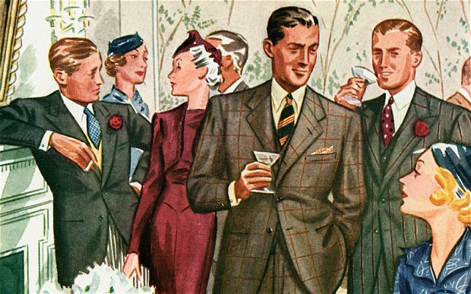
A Decades Old Question

Slide 4
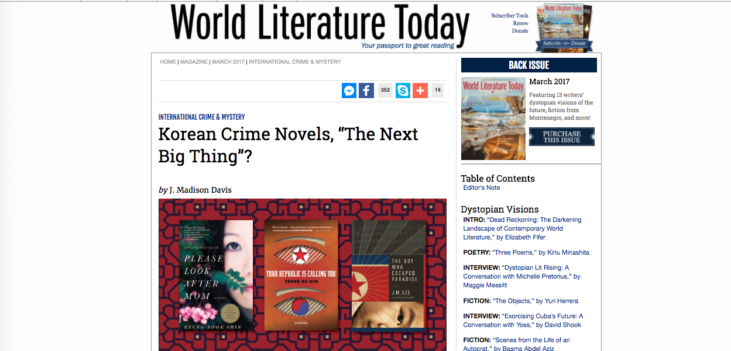
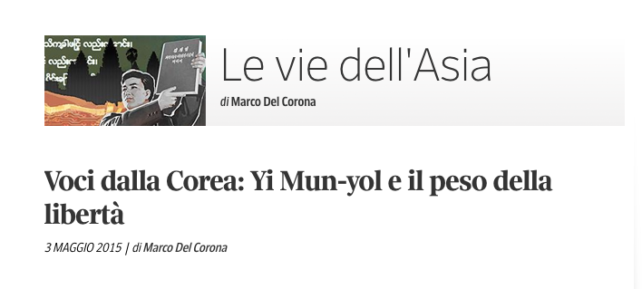
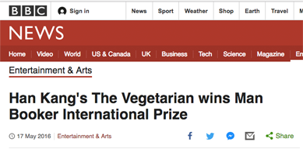
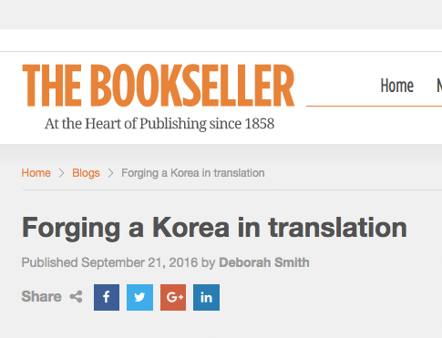
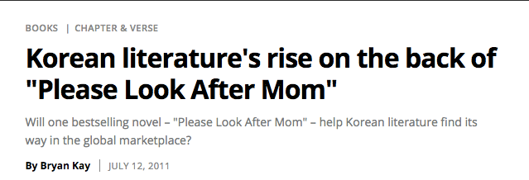
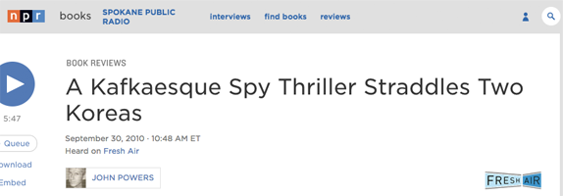
Recently

Slide 5
What I Will Discuss
Why can Korean literature be so different from Western literature??^^
Relationship between literature & culture/history
Eras of Korean literature
Translation issues
Recommendations

Slide 6
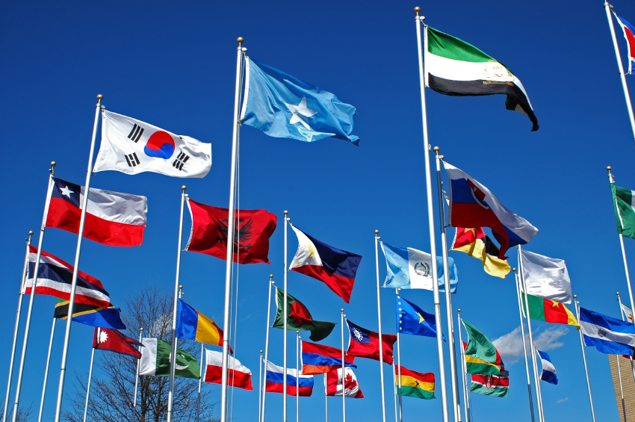
Some Cultural Differences*
Very Broad Strokes Adapted from Chinese-born German designer Yang Liu. *That just might influence readers or writers.^^

Slide 11
High Context / Low Context

Slide 12
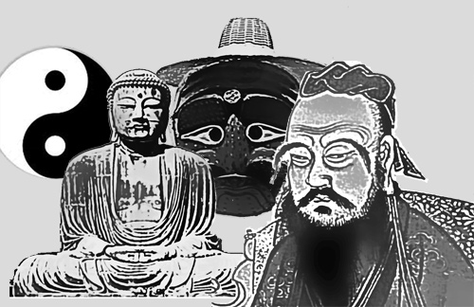
Influences
Animism
Shamanism
Buddhism
Confucianism
Christianity (but later)

Slide 13
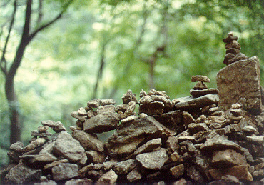
Animism

Slide 14
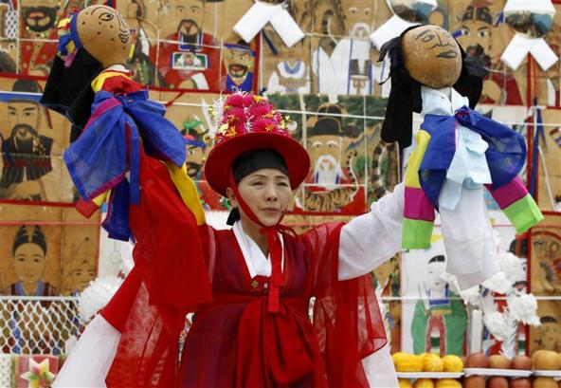
Shamanism
Notes:
Roots in folk beliefs related to ancient communal worship rites offered to gods
Resolution of problems through meeting of humans and spirits mediated by shamans
Three elements are seen as essential to a “goot” (Korean shamanistic ritual): the spirits as the object of folk beliefs, the believers praying to those spirits, and the shaman mediating between the spirits and the believers.

Slide 15
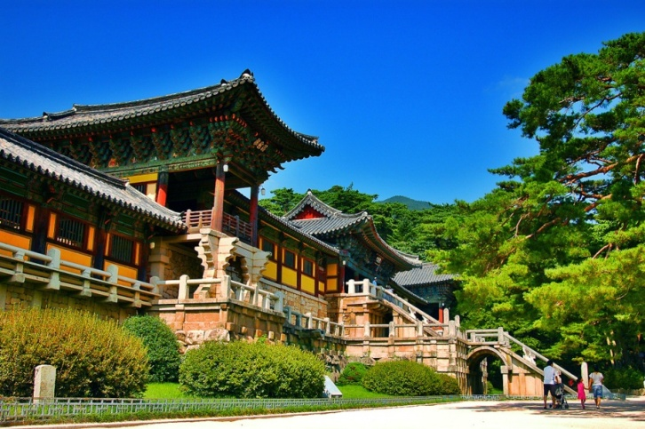
Korean Buddhism
Notes:
Introduced in three kingdom era (@ 372 A.D.)
State religion in three kingdoms and Goryeo
Deep influence in every aspect of Korean life
Korea still 24% Buddhist.
Buddhism is a philosophy and religion, brought to Korea almost 1800 years ago. The principles of Buddhist teaching are deeply rooted in the way of life among Koreans regardless of their religion.
Many national treasures in art and architecture are Buddhism related, such as, Buddhist temple buildings or statues of Buddha.

Slide 16
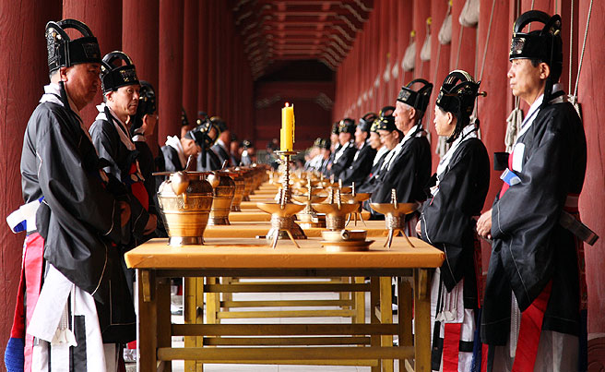
Korean Confucianism
Notes:
Joseon dynasty promoted Confucian philosophies as national philosophy.
Intellectual Achievement
‘Proper’ Social Structure
Joseon dynasty adopted Confucianism as its ruling ideology. Important Korean Confucian ceremonies are “coming of age at age 15 years”, marriage, death, and the anniversary of an ancestor’s death. Among these, funerals had the greatest effect on people’s lives. The funeral was a way of expressing one’s innermost feelings, and its conduct and atmosphere depended on the degree of intimacy or formality in the relationship between the living and the deceased. The Joseon promoted a revised form of Confucianism,calld Neo-Confucianism, that had also been developed in China. In the 18th and 19th centuries, scholars developed and promoted the emergence of Silhak, or Practical Learning, which some see as an early step toward modern social and scientific practices.

Slide 17
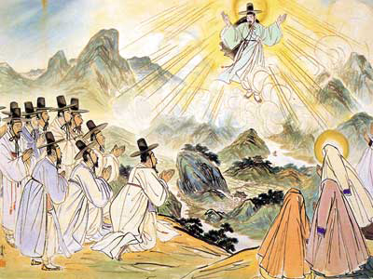
Christianity

Slide 18
What Does It Add Up To?
Moral or dynastic codes underlie a social system, which:
Sits on top of a socially bifurcated society
At the very least fiction is aimed at “something”

Slide 19
What Barriers Does this Create?
Flat Affect (High Context – No heroes)
Less Agency (Social Determination)
Gatekeeping
Didacticism
Less interest in character motivation
Plot < message

Slide 20
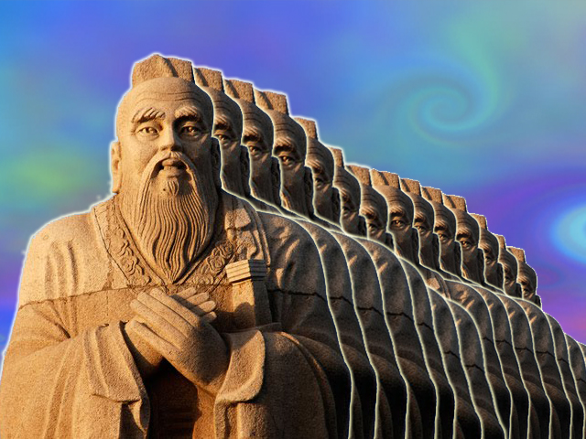
This can be wildly over-orientalized

Slide 21
Bad Translation
(De) Amplification
Bad themes/genres – Sonagi/Buckwheat
Literality
Impossibility
Bad incoming translation

Slide 22
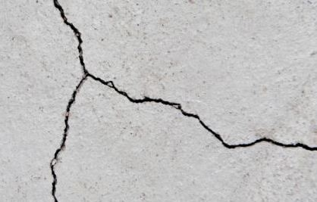
Literature – Dividing Lines
Classical (? – Late 19th Century)
Enlightenment (Late 19th Century)
Modern (1910 – Now)
Post-Modern
Notes:
Is Yi’s creation of Pundan munhak at this time

Slide 23
Literature – Dividing Languages
Hyangch’al
Chinese
Hangul

Slide 24
Koryo Kasa (57 BC to 935 AD: Silla)
One to thirteen stanzas
Stanzas have refrain in the middle/end to establish mood or link the stanzas
Informal, bolder, Kisaeng

Slide 25
The Manjeoncheun
When I lie alone, restless, vigilant, Only peach blossoms wave over the west window. You have no grief, welcome the spring breeze.
I have believed those who vowed to each other; "My soul will follow yours forever." Who, who persuaded me this was true?
"O duck, beautiful duck, why do you come To the swamp, instead of the shoal?" "If the swamp freezes, the shoal will do."
A bed on Mount South, jade pillow, gold brocade. And beside me a girl sweeter than musk, Let us press our hearts together, our magic hearts.

Slide 26
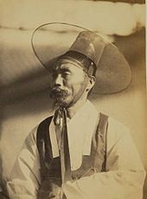
Sijo (Koryo: 993 - to present)
Joseon poetry shifts to sijo/kasa written by Yangban
3 lines of 14-16 syllables each. Total syllables between 44 and 46
Rules almost always broken, as sijo aren’t really syllabic^^

Slide 27
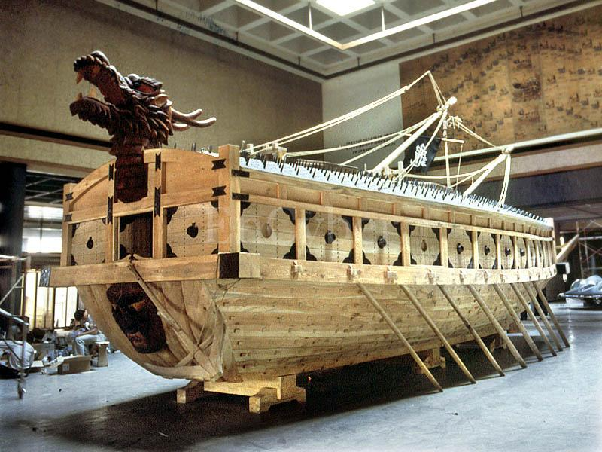
Yi Sun-sin
Moon-bright night on Hansan Isle and I sit alone atop the lookout. I hold my great sword by my side, and as my worries deepen, from somewhere comes the single note of the Mongol flute, piercing to the very bowels.

Slide 28
Joseon Kasa (1500-1700)
Free verse, based on a rhythm of doubled feet with three or four syllables
Not stanzas
More narrative/descriptive

Slide 29
Kasa
There is between heaven and earth many a man who’s worth as I. Why don’t they know the great Joy Of living in the wooded mountains? With a grass hut of a few bays built to face a clear blue stream, In the lush wood of pine and bamboo I am the master of wind and moon.

Slide 30
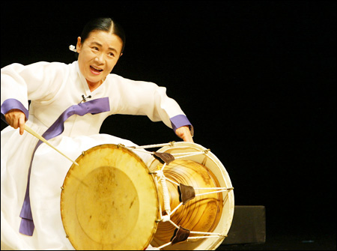
Pansori (판소리)
Narrative poetry focused on real life from shamanist chants of S-E Korea in late 17th and early 18th centuries
Long narrative musical performance with drummer (고수) and singer (소리꾼)

Slide 31
Korean Classical Literature (Origins)
Oral (Just like West)
Therefore often poetic (Just like West)
Chinese Characters
Informed by influences just noted

Slide 32
Korean Classical Prose - History
Narratives, fiction, and miscellany
Samguk sagi (1146; "Historical Record of the Three Kingdoms")
Samguk yusa (1285; "Memorabilia of the Three Kingdoms")
Lots of folk tales
Notes:
A biography of worldly desires under Confucianism.

Slide 33
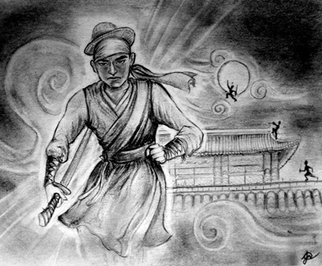
Classical Prose - Literature
Tales of Kumo by Kim Shi-sup in 1445-68
The Tale Of Hong Gildong by Hyo Kyun (1569 – 1618)
Notes:
Kumo – Biographical tale of conflict between worldly desires and Confucianism.

Slide 34
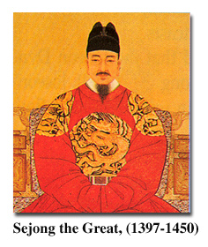
Korean Alphabet: Hangul
Invented by King Sejong the Great in 1446
14 consonants & 10 vowels
"A wise man can acquaint himself with them before the morning is over; a stupid man can learn them in the space of ten days”.
Notes:
Hangul is the only alphabet in the whole world invented by one person. It is a purely phonetic alphabet with 10 vowels and 14 constants.
Koreans used Chinese characters before the invention of Korean alphabet. The majority of Koreans were effectively illiterate before the invention of Hangul.
In explaining the need for the new script, King Sejong explained that the Korean language was different from Chinese; using Chinese characters to write was so difficult for the common people that only privileged aristocrats, usually male, could read and write. Hangul was designed so that even a commoner could learn to read and write.
"Hunmin Jeong-eum Explanation and Examples“ explains the design of the consonant letters according to “articulatory phonetics” and the vowel letters according to the principles of “yin and yang” and “vowel harmony”.
From http://library.thinkquest.org/20746/non/info/index.html

Slide 35
Korean Economy– 5 Centuries in 1; Modern Literature Eras 3 Centuries in 1
Enlightenment (End of Joseon)
Colonial (Three eras)
Separation
Industrialization / Modernization
Post Modern
Notes:
Commercial farming begins in the 16th century in Britain.

Slide 36
Enlightenment
Gabo Reforms of 1894-6
1895: Yu Kiljun Things Seen and Heard on a Journey to the West
Serial novels in newspapers ( Hansong Sunbo began publishing 1883)
1906: Yi In-jik’s Tears of Blood (female protagonist / modern outlook / set in Pyongyang)
1907: Jang Ji-yeon’s Tale of the Patriotic Lady (Imaging Joan of Arc in a Korean setting)

Slide 37
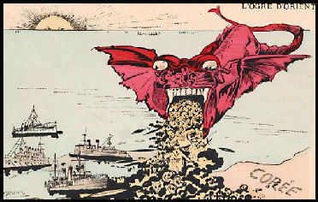
Colonialism
Forced Modernization/Japanization
Three eras – 1,2,3
Stories of no opportunity
The “Modern” Woman
Nature stories
Collaboration

Slide 38
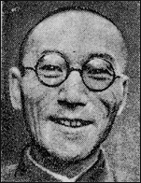
Yi Kwangsu
1910-1916 ‘Invents’ “Munhak” (문학)
1910-19 (Heartless) attacks Korea's traditions advocates adopting a western worldview
20s - 30’s, nationalist advocates moral change and blames Koreans for being passive (Soil)
30’s is Buddhist & in 37 jailed and comes out a complete collaborator.
Snagged by NK, dies up north.

Slide 39
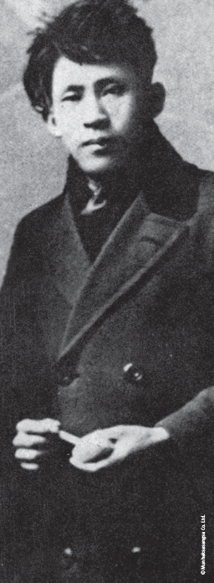
Yi-Sang
Most works during the 1930s
Architect/Draftsman
1936 arrested for “thought crimes ” Tubercular/worsens in prison, dies April 17, 1937
Also ‘modern’ poet

Slide 40
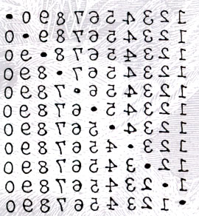
Yi-Sang: Poet

Slide 41
War
Few stories of the war as a whole – tend to be very specific events
Not over, not noble, no one won.
How in Heaven's Name: A Novel of World War Two by Cho Chongnae
Notes:
Not overn not noble, no one one.. Compare to Vietnam

Slide 42
Separation Period / Pundan Munhak (1945-Present)
Hwang Sun-won’s Cranes or his Descendants of Cain.
Jo Jung-Rae’s The Land of the Banished
Hyun Ki-young’s Sun’i Samch’on
Hwang Sok-yong’s The Guest

Slide 43
Separation
Sonagi
The Shaman Sorceress

Slide 44
The Trek North
Han Sorya
Yi Kiyong
Kim Namchon
Im Hwa
Perhaps one-third?

Slide 45
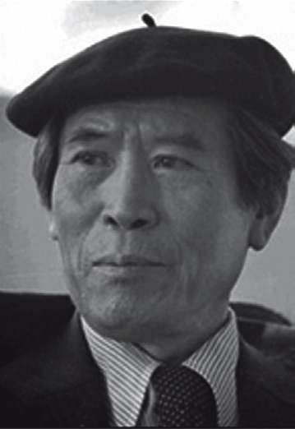
Hwang Sun-won: Korea’s Dickens
Writer, novelist, and poet
Began in Colonial Period
Refused to write in Japanese – went underground

Slide 46
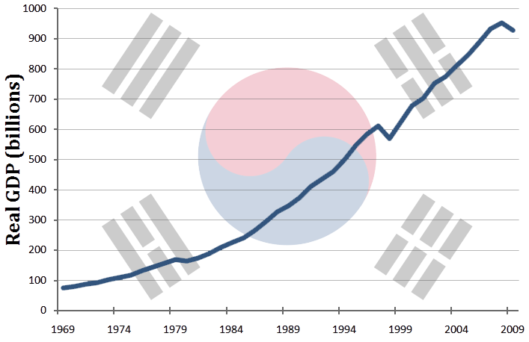
Miracle on the Han: Economics
Cho Se-hui’s The Dwarf (yŏnjak sosŏl)
Yang Gui-Ja’s A Distant and Beautiful Place
The Road to Sampo (황석영)

Slide 47
Miracle on the Han: Politics
Ch’oe Yun’s There a Petal Softly Falls
Lim Chul-woo’s Straight Lines and Poison Gas
Gong Ji-young’s Human Decency
Han Kang’s Human Acts

Slide 48
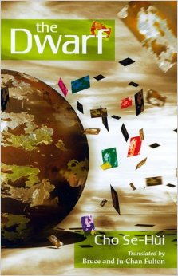
Cho Se-Hui: The Dwarf
The Dwarf is a yŏnjak sosŏl
3 stories in 1 (each story segmented)
Government mandated loss of Community & economic dislocation

Slide 49
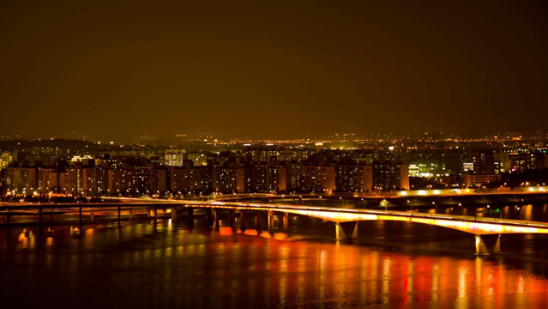
Modern Period (198? – Now)
Kim Young-ha’s work
No One Writes Back (Jang Eun-jin)
Please Look After Mom (Shin Kyung-sook)
Many of the authors I will note at the end of this presentation

Slide 50
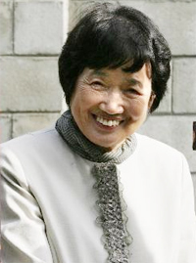
Yoryu Chakga: The Changing Status of Women Writers
A Genre unto Themselves:
Women Writers and Segregation
Turn of the Century:
Women Writers as the Dominant Force in Korean Literature
Hangul & Education

Slide 51
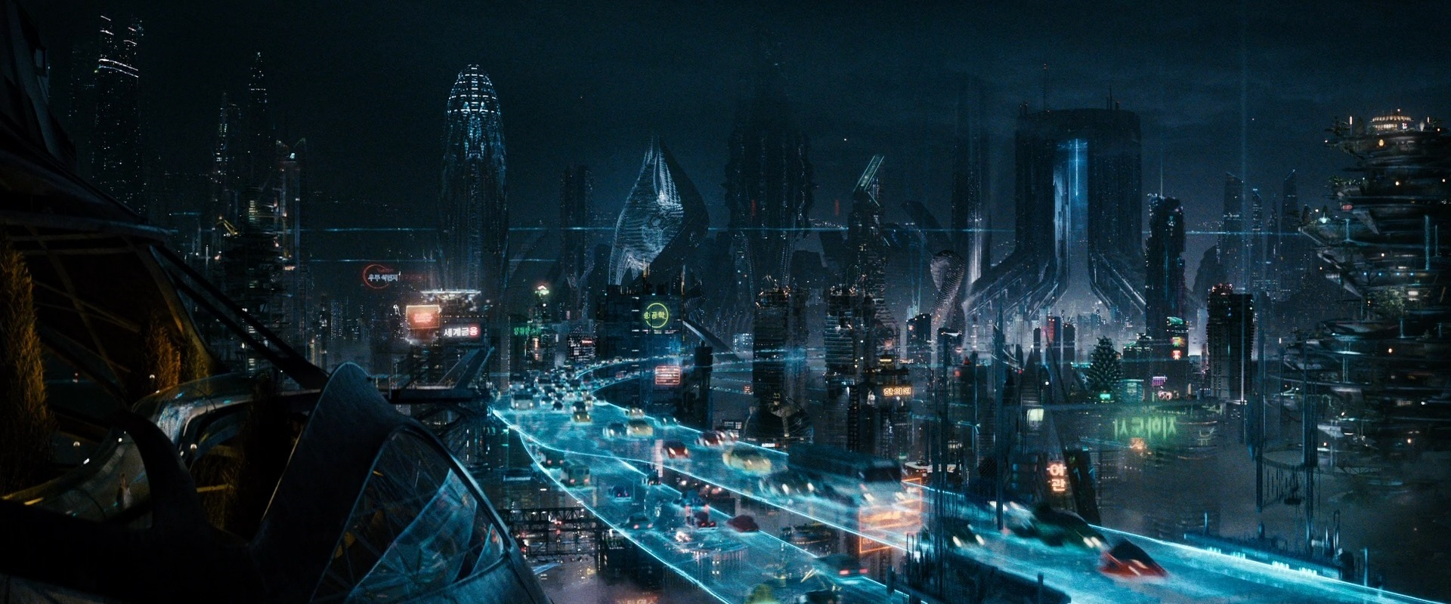
The Future
Revisiting Language and Ethnicity
Koreans in English
Others in Korean
Internationalization
Nobel Prize
Shin Kyung-sook
Tension with “national” literature
Nationalism in Literary Production
Writers Unbound
Kim Young-ha
Kim In-sook
Park Sang-ryoong

Slide 52
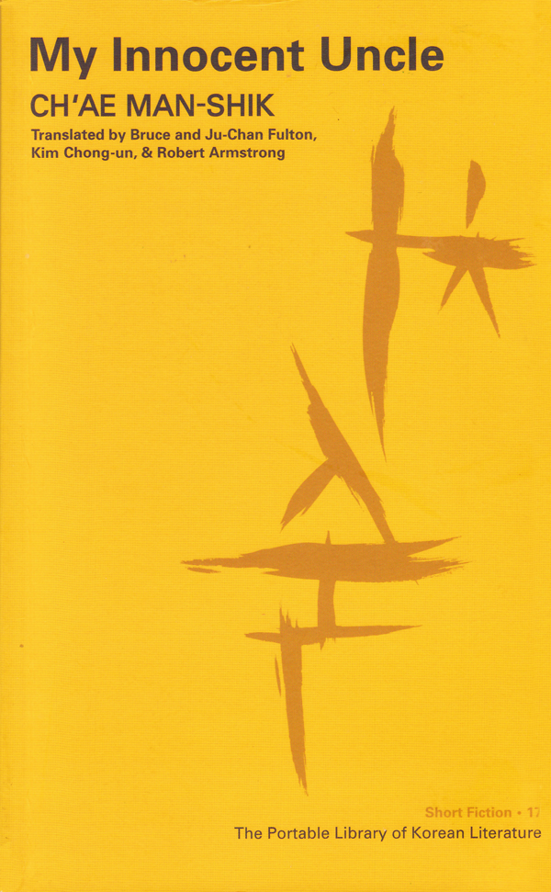
Funny?
Ch’ae Mansik
Some collaboration fiction
Most North Korean fiction^^

Slide 53
Romance?
The Scorching Heat (Ch’ae Mansik)
Descendants of Cain
The Flower with 13 Fragrances
Probably not sexualized enough

Slide 54
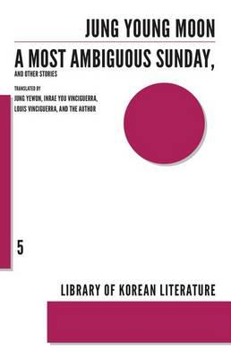
Modern to Post-Modern
Jang Eun-jin – No One Writes Back
Shin Kyung-sook - Please Look After Mother
Cheon Myeong-kwan – Homecoming
Kim Young-Ha
Pak Min-Gyu

Slide 55
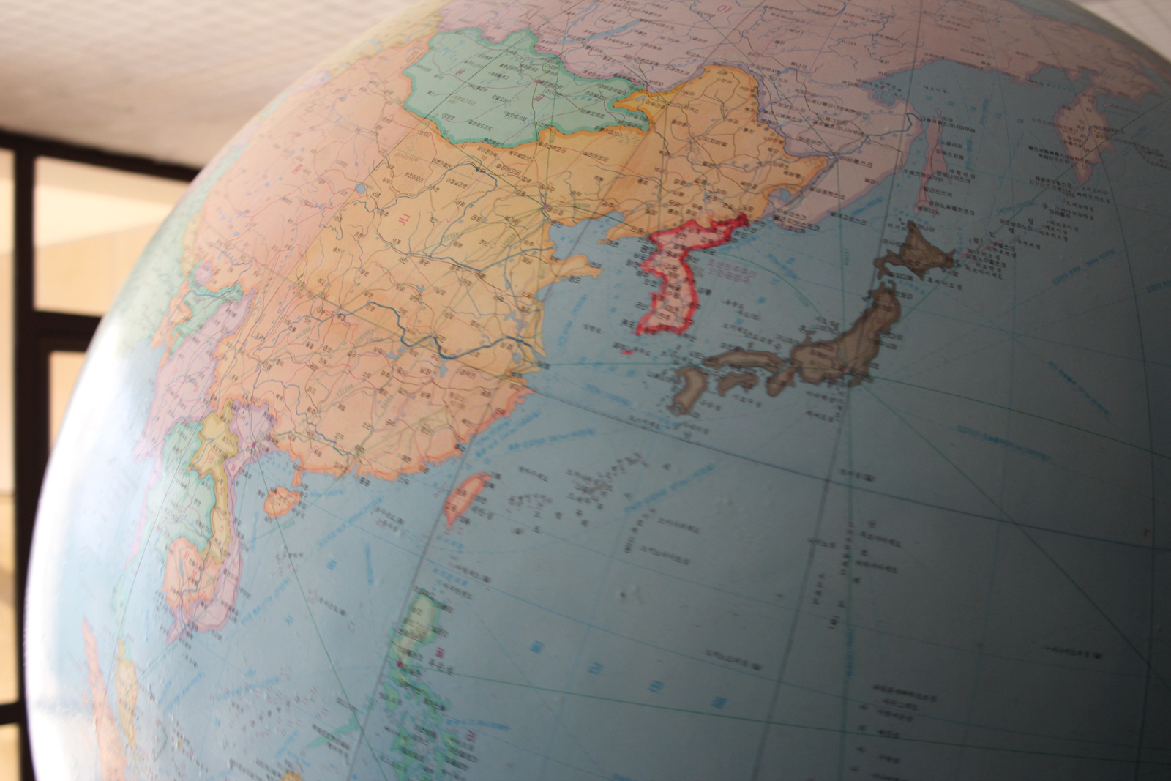
International
Deep Blue Night – Choi In-ho
The Long Road – Kim In-suk
The Human Jungle – Jo Jung-rae
Time to Eat Lobster - Bang Hyun-seok

Slide 56
The Translation “Problem”
Please Look After Mom (엄마를 부탁해)
The Vegetarian (채식주의자)

Slide 57
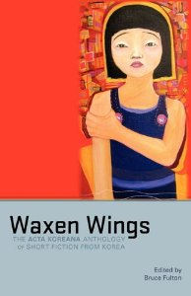
Collections: General
Modern Korean Fiction: An Anthology
Land of Exile
Waxen Wings

Slide 58
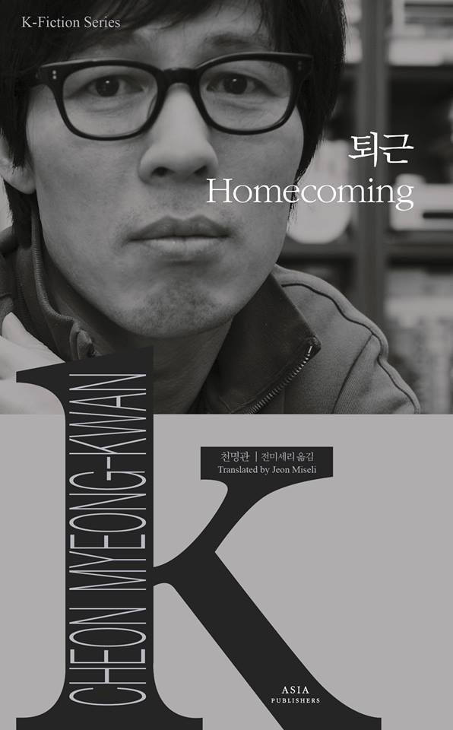
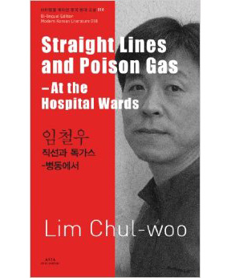
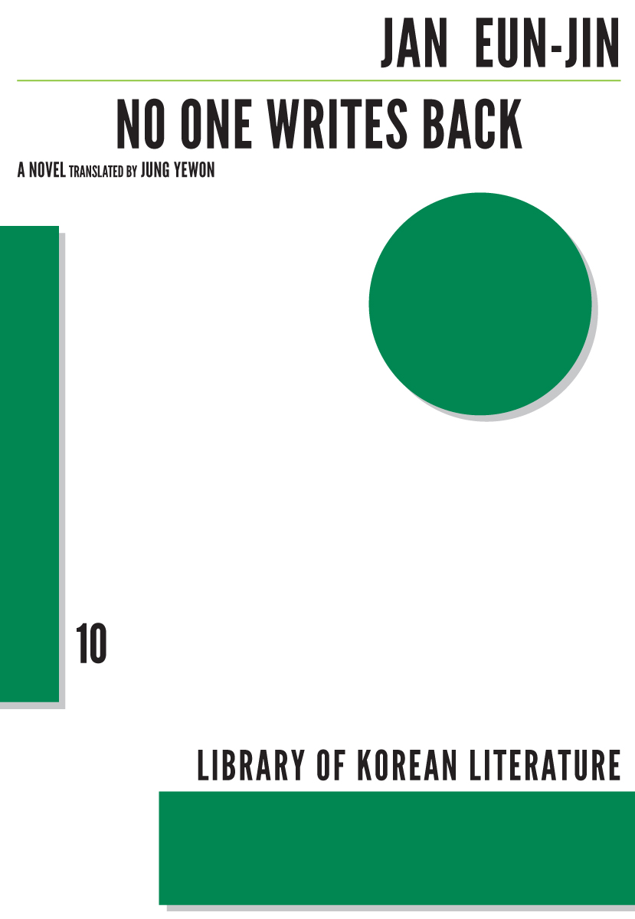
Multi Volume Collections
Asia Publishers 110 books
Dalkey / LTI Korea
Asia Publishers K-Fiction

Slide 59
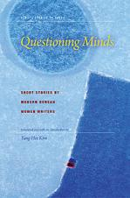
Collections: Women’s Literature
Words of Farewell: Stories by Korean Women Writers
Questioning Minds

Slide 60
Authors
Yi Mun-yol
Pak Wan-so
Ch’oe Yun
Hwang Sun-won
Kim Young-ha
Han Kang
Jo Jung-rae

Slide 61
Resources
All the Literature that’s free^^
Brother Anthony’s hompi
Korea Journal
LTI Korea website
WWW.KTLIT.COM
Korean Film Archive

Slide 62
Find Me
WWW.KTLIT.COM
CHARLES@KTLIT.COM
@KTLIT

